Slide 1
Regression Analysis
Simple Linear Regression
Nicoleta Serban, Ph.D.
Professor
School of Industrial and Systems Engineering
Example 1: Testing the Theory of Purchasing Power Parity
(Part 1)

Slide 2

About This Lesson

Slide 3
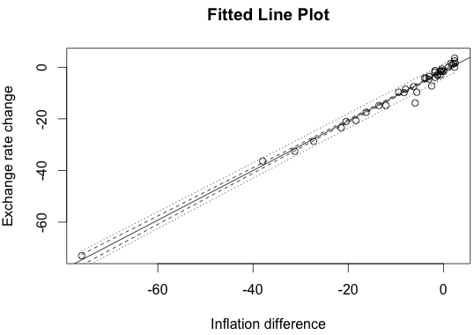
Confidence Bands in R
# Function for fitted line plot: See ppp-revised.R for this function
#regplot.confbands.fun = function(x, y, confidencelevel=.95, CImean=T, PI=T, CIregline=F, legend=F){
#### Modified from a function written by Sandra McBride, Duke University
….}
regplot.confbands.fun(Inflation.difference,Exchange.rate.change)
The fitted line plot shows several lines:
  The continuous line is the fitted regression line.
  The wider interrupted line band is the prediction confidence band.
  The narrower interrupted line band is the confidence band.
  The circles correspond to outliers.

Slide 4
Confidence and Prediction Intervals
# Confidence and prediction intervals for new observation
# Create new data point
newppp = data.frame(Inflation.difference = c(-0.68))
# Specify whether a confidence or prediction interval
predict(pppa,newppp,interval=c("confidence"))
fit lwr upr
1 -2.173351 -2.756818 -1.589884
predict(pppa,newppp,interval=c("prediction"))
fit lwr upr
1 -2.173351 -5.554071 1.207369
## Why are the intervals different?
Interpretation of the two intervals:
The 95% confidence limits of the average exchange rate change for all countries inflation difference equal to -0.68 are (-2.757,-1.590);
The 95% confidence limits for the exchange rate change for one country with inflation difference equal to -0.68 are (-5.554,1.207).

Slide 5
Residual Analysis in R
par(mfrow=c(2,2))
plot(Inflation.difference, residuals(pppa),xlab="Inflation Difference",ylab="Residuals",main="Versus Predictor")
abline(h=0,lty=2)
plot(fitted(pppa),residuals(pppa),xlab="Fitted values",ylab="Residuals“, main="Versus Fits")
abline(h=0,lty=2)
qqnorm(residuals(pppa))
abline(0,1,lty=1,col="red")
hist(residuals(pppa),main="Histogram of residuals",xlab="Residuals")

Slide 6
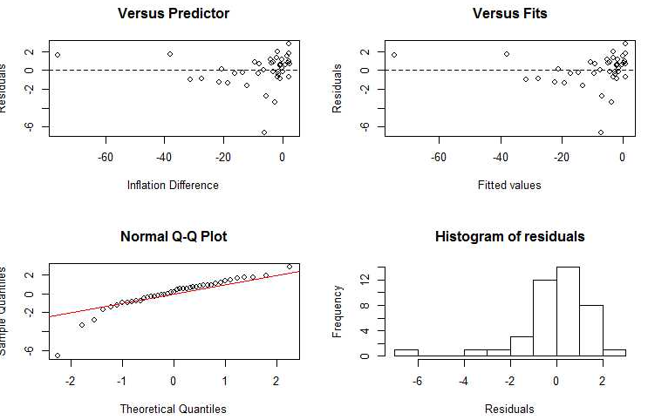
Residual Analysis in R

Slide 7
Residual Analysis in R
Leverage Points: The isolated point in residual plots is Brazil. Why is Brazil a leverage point?
Brazil had a period of hyperinflation from 1980 to 1994, a time period during which prices went up by a factor of roughly 1 trillion.
Why do we care about leverage points?
It can have a strong effect on the fitted regression, drawing the line away from the bulk of the points. It also can affect measures of fit like R-squared and t–statistics.
Notes:
Show slide only:
There are unusual observations in these plots. In the plot of residuals versus fitted values
one point is isolated all the way to the left of the plot, corresponding to a very unusually low
fitted value (estimated exchange rate change).
This is Brazil, which has an annualized inflation rate more than 75 percentage points higher than that of the United States. This is a leverage point, and it is a problem. A leverage point can have a strong effect on the fitted regression, drawing the line away from the bulk of the points. It also can affect measures of fit like R2, t–statistics. What is going on here? Brazil had a period of hyperinflation from 1980 to 1994, a time period during which prices went up by a factor of roughly 1 trillion (that is, something that cost 1 Real at the beginning of the 1980s cost roughly 1 trillion Reals in the mid- 1990s). This hyperinflation was caused by an expansion of the money supply; the government financed projects not through taxes or borrowing but simply by printing more money, a crisis triggered by the worldwide energy crisis of the 1970s and political instabilities of the Brazilian military dictatorship. It is worth noting that this shows how changing the definition of “long term” can change the numbers for a country dramatically (the numbers for Brazil would be noticeably different if the starting time period was 1985 rather than 1975, and would be dramatically different if it was 1995 instead of 1975), because of the dependence of the annualized rates on the first and last values.

Slide 8
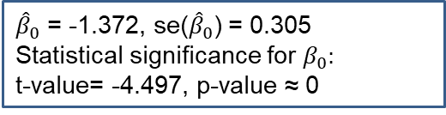
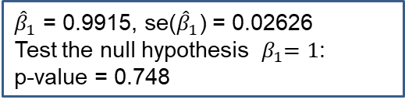
Influential Points in Regression Analysis
##### Repeat Analysis: Omit Brazil #########
## remove the data row corresponding to Brazil
newppp = ppp[ppp$Country!="Brazil",]
attach(newppp)
## Fit Linear Regression
pppn = lm(Exchange.rate.change ~ Inflation.difference)
summary(pppn)
Coefficients:
Estimate Std. Error t value Pr(>|t|)
(Intercept) -1.37222 0.30517 -4.497 6.31e-05
Inflation.difference 0.99152 0.02626 37.757 < 2e-16
Residual standard error: 1.62 on 38 degrees of freedom
Multiple R-squared: 0.974, Adjusted R-squared: 0.9734
${\hat{β}}_{0}$ = -1.372, se(${\hat{β}}_{0}$) = 0.305
Statistical significance for $β_{0}:$
t-value= -4.497, p-value ≈ 0
${\hat{β}}_{1}$ = 0.9915, se(${\hat{β}}_{1}$) = 0.02626
Test the null hypothesis ${ β}_{1}=1$:
p-value = 0.748
We are seeing violations of PPP with respect to intercept only.
## Test whether the slope is equal to 1 (PPP theory)
tvalue = (0.9915−1)/ 0.02626
pvalue = 2*(1-pt(abs(tvalue),38))

Slide 9
Residual Analysis: Model without Brazil
par(mfrow=c(2,2))
plot(Inflation.difference, residuals(pppn),xlab="Inflation Difference",ylab="Residuals",
main="Versus Predictor")
abline(h=0,lty=2)
plot(fitted(pppn),residuals(pppn),xlab="Fitted values",ylab="Residuals",main="Versus Fits")
abline(h=0,lty=2)
qqnorm(residuals(pppn))
abline(0,1,lty=1,col="red")
hist(residuals(pppn),main="Histogram of residuals",xlab="Residuals")

Slide 10
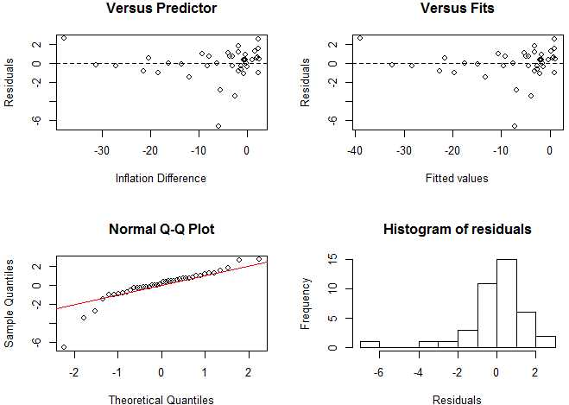
Residual Analysis: Model without Brazil
Assumptions:
Linearity: No pattern in the residuals with respect to the predicting variable.
Constant Variance: The variance is higher for higher fitted values. Does not hold.
Uncorrelated Errors: No grouping of the residuals
Normality: Except for the presence of an outlier, it is reasonably symmetric.
Outliers (observations for which the residual value is away from the range):
The isolated point in the residual plots is Indonesia. Would omitting Indonesia change anything? The strength of the relationship would increase, but so the rejection of PPP.

Slide 11
Testing the Theory of Purchasing Power Parity
Findings:
Support is decidedly mixed
Developed countries:
  Changes in inflation difference do seem to be balanced by exchange rate changes
  One outlier: Greece
Developing countries:
  The case for PPP is considerably weaker;
  Brazil and Indonesia
PPP is not robust to unusual economic or political conditions

Slide 12

Summary

